Slide 1

Module 2: Matrices
Department of Mathematics Jain Global campus, Jakkasandra Post, Kanakapura Taluk, Ramanagara District -562112
Prof. VEERESH MALAGI
Department of Mathematics,
FET, Jain(Deemed-to-be-University)

Slide 2
Consistency of a system of linear equations
Consider a system of ‘m’ linear equations in ‘n’ unknowns as follows
……… ……..
……… ……..
If are all zero, the system is said to be homogeneous. Otherwise, it is said to be Non-homogeneous.
The set of values which satisfy all the equations simultaneously is called a solution of the system of equations.
A system of linear equations is said to be consistent if it possess a solution. Otherwise it is said to be inconsistent.

Slide 3
The above system of equations can be written in the matrix equation A X = B, where
is a solution of the homogeneous system of equations and is called a trivial solution.
If at least one x_{i} , (i = 1, 2, …, n) is not equal to zero then it is called a non trivial solution.
The concept of the rank of a matrix helps us to conclude
(i). Whether the system is consistent or not.
(ii). Whether the system possess unique solution or many solution.

Slide 4
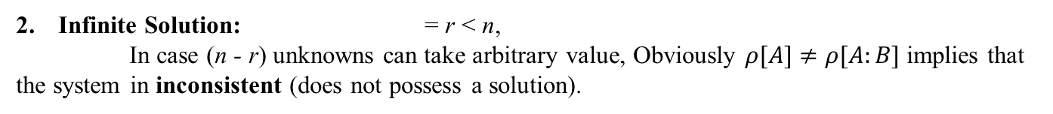
Condition for consistency and types of solution
Consider a system of m equations in n unknowns represented in the matrix form AX = B
Here A is called the coefficient matrix.
The matrix formed by appending to A an extra column consistent of the elements of B is called the augmented matrix denoted by [A: B]
The system of equations represented by the matrix equation AX = B is consistent if
Suppose =r, then the condition for two types of solution are as follows.
1. Unique Solution: = r = n, (where n is the number of unknowns).
Infinite Solution:= r<n,
In case (n - r) unknowns can take arbitrary value, Obviously $ρ[A]≠ρ[A:B]$ implies that
the system in inconsistent (does not possess a solution).

Slide 5
Working procedure for problems
Step 1: We first form the augmented matrix [A: B] and we can clearly identify the portion of the coefficient matrix A in it.
Step 2: We reduce the matrix [A: B] to an echelon form by elementary row transformations. This will enable us to immediately write down the rank of A and also [A: B], with the result we can decide the consistency aspect of the system of equations.
Step 3: The echelon form of [A: B] is converted back to the equation form and the solution will emerge easily.

Slide 6
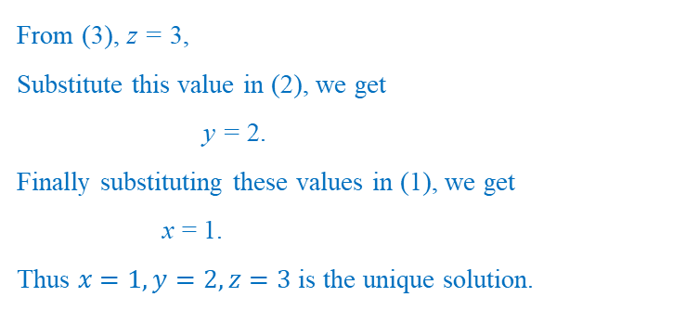
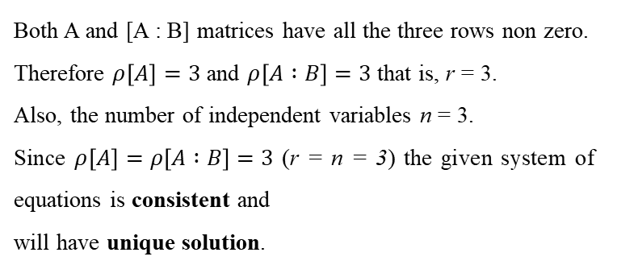
Problems
1. Test for consistency and solve
Solution:
Both A and [A : B] matrices have all the three rows non zero.
Therefore $ρ\left[A\right]=3$ and $ρ\left[A :B\right]=3$ that is, r = 3.
Also, the number of independent variables n = 3.
Since $ρ\left[A\right]=ρ\left[A :B\right]=3$ (r = n = 3) the given system of equations is consistent and
will have unique solution.
Let us now convert the prevailing form of [A : B] into a set of equations as follows,
From (3), z = 3,
Substitute this value in (2), we get
y = 2.
Finally substituting these values in (1), we get
x = 1.
Thus $x=1, y=2, z=3$ is the unique solution.
[Note: We need not make the leading non zero entry in every row 1 as we can decide on the rank of the matrices A and [A: B] at this stage.]

Slide 7
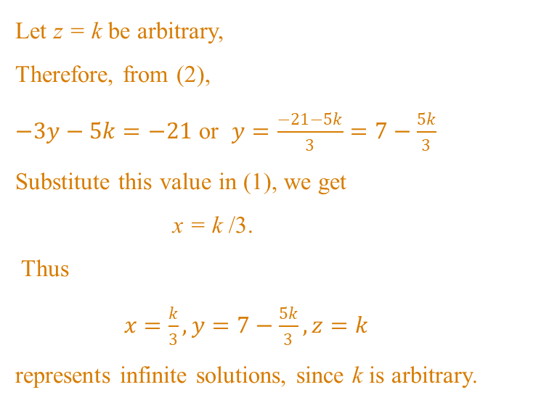
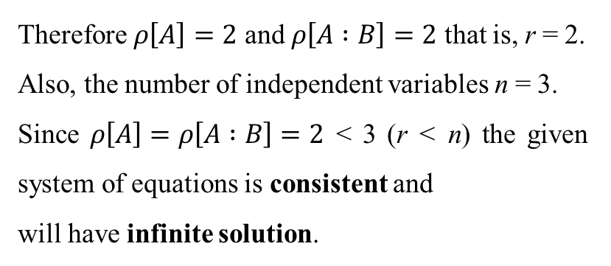
2. Test for consistency and solve
Solution:
Here (n - r) = 1 and hence one of the variables can take arbitrary values.
We now have,
Let z = k be arbitrary,
Therefore, from (2),
$−3y−5k=−21$ or $y=\frac{−21−5k}{3}=7−\frac{5k}{3}$
Substitute this value in (1), we get
x = k /3.
Thus
$x=\frac{k}{3}, y=7−\frac{5k}{3}, z=k$
represents infinite solutions, since k is arbitrary.
Therefore $ρ\left[A\right]=2$ and $ρ\left[A :B\right]=2$ that is, r = 2.
Also, the number of independent variables n = 3.
Since $ρ\left[A\right]=ρ\left[A :B\right]=2$< 3 (r < n) the given system of equations is consistent and
will have infinite solution.

Slide 8
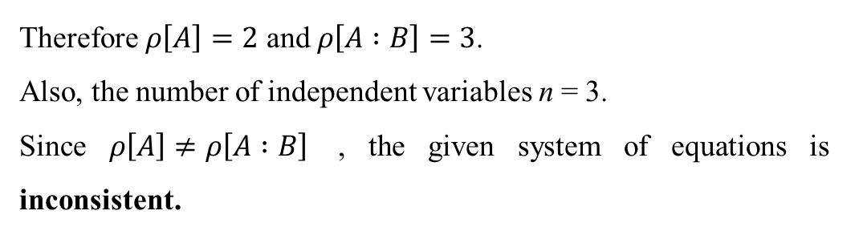
3. Test for consistency and solve
Solution:
Therefore $ρ\left[A\right]=2$ and $ρ\left[A :B\right]=3$.
Also, the number of independent variables n = 3.
Since $ρ\left[A\right]≠ρ\left[A :B\right]$ , the given system of equations is inconsistent.

Slide 9
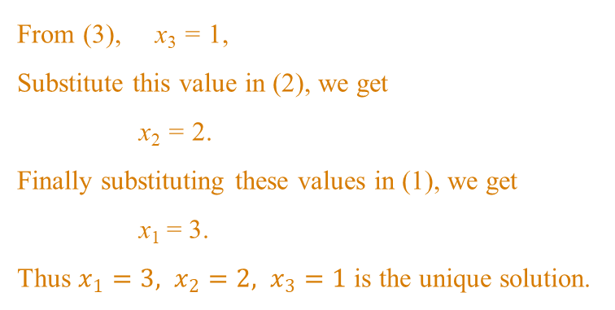
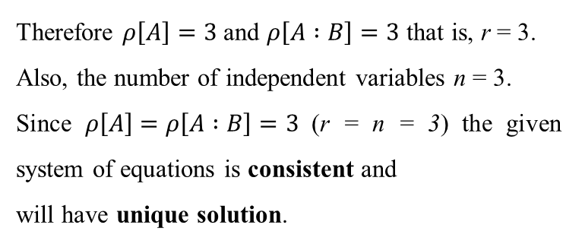
4. Test for consistency and solve
Solution:
Let us now convert the prevailing form of [A : B] into a set of equations as follows,
From (3), x₃= 1,
Substitute this value in (2), we get
x₂= 2.
Finally substituting these values in (1), we get
x₁= 3.
Thus $x_{1}=3, x_{2}=2, x_{3}=1$ is the unique solution.
Therefore $ρ\left[A\right]=3$ and $ρ\left[A :B\right]=3$ that is, r = 3.
Also, the number of independent variables n = 3.
Since $ρ\left[A\right]=ρ\left[A :B\right]=3$ (r = n = 3) the given system of equations is consistent and
will have unique solution.

Slide 10
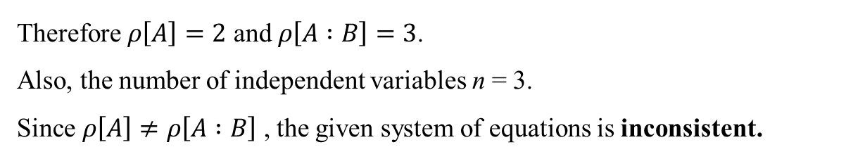
Show that the following system of equation
does not possess any solution
Solution:
Therefore $ρ\left[A\right]=2$ and $ρ\left[A :B\right]=3$.
Also, the number of independent variables n = 3.
Since $ρ\left[A\right]≠ρ\left[A :B\right]$ , the given system of equations is inconsistent.

Slide 11
6. Investigate the values of and such that the system of equations
may have
a] Unique solution b] Infinite Solution c] No solution.
Solution:

Slide 12
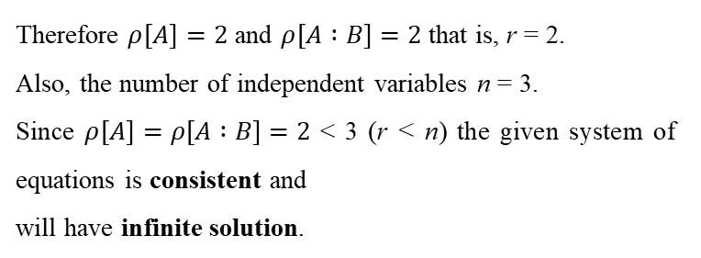
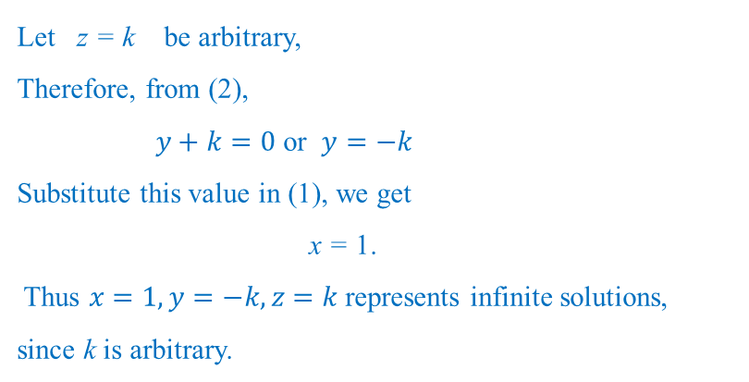
7. Test for consistency and solve
Solution:
Therefore $ρ\left[A\right]=2$ and $ρ\left[A :B\right]=2$ that is, r = 2.
Also, the number of independent variables n = 3.
Since $ρ\left[A\right]=ρ\left[A :B\right]=2$< 3 (r < n) the given system of equations is consistent and
will have infinite solution.
Here (n - r) = 1 and hence one of the variables can take arbitrary values.
We now have,
Let z = k be arbitrary,
Therefore, from (2),
$y+k=0$ or $y=−k$
Substitute this value in (1), we get
x = 1.
Thus $x=1, y=−k, z=k$ represents infinite solutions, since k is arbitrary.

Slide 13
Thank You

